Slide 1


NASDAQ:FMFF
NYSE:FDGC
Follow us

Slide 2

The Company
Fudgecorp - parent company of Fudgeflix and Fudgemart
Fudgeflix is a recent addition, and stakeholders want to learn more about the customer overlap between the subsidiaries.
Fudgemart sells a variety of products and ships them to customers at no extra cost.
Fudgeflix offers streaming services and DVD rentals.
Fudgecorp executives believe the merger will grow the enterprise by offering a “one-stop shop” to customers.

Slide 3
Project Charter
Mission
Develop a data dashboard where stakeholders can assess performance metrics and KPIs across the enterprise, increase marketing effectiveness, and analyze employee costs to the business over time.
Business Case
This project has the potential to provide short-term incremental benefits as well as revenue and marketing breakthroughs over the long run.
Stakeholders
Marketing, business analytics, finance/accounting, and executives
Project Team
Cartney Thompson
Jack Harris
Michael Morales

Slide 4




Business Processes
Stakeholders want to know the total revenue across both Fudgeflix and Fudegmart. This will allow the total revenue of Fudgecorp to be calculated, and will also enable stakeholders to compare and contrast each entity’s performance.
Stakeholders want to know where there is customer overlap between Fudgeflix and Fudgemart. This will give them more marketing information than they can currently obtain from the entities separately.
Fudgecorp needs to make better use of product/rental categorizations to gather more data about customer purchasing behavior.
FudgeCorp, specifically Fudgemart, needs to know how much employee costs has changed over time to better optimize expenditure on employees.
Notes:
More info means more knowledge of customer behavior and desire. Beer and diapers example – they don’t seem to be related, but there is a correlation in practice.

Slide 5
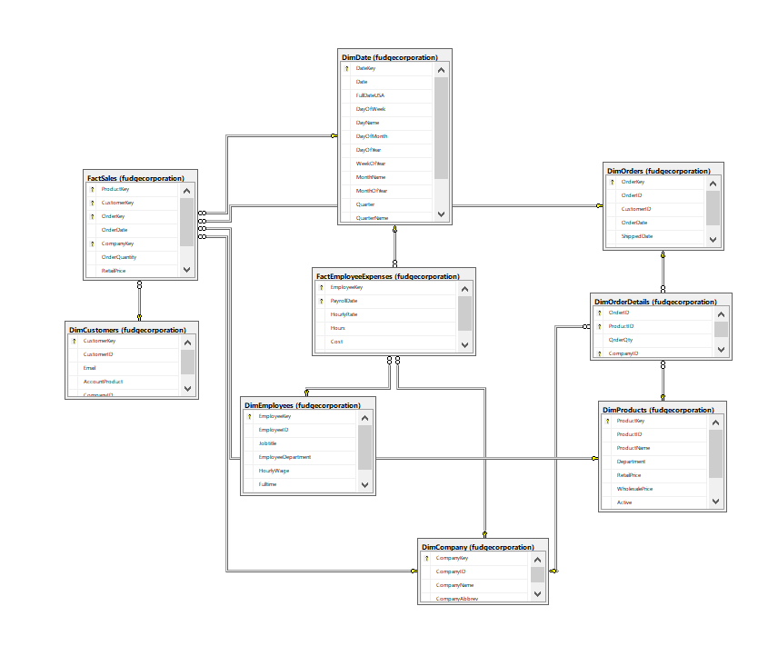
Star Schema

Slide 6
Performance Revenue Summary
FudgeMart
FudgeFlix
Notes:
99% of FudgeCorp’s Revenue from FudgeMart

Slide 7
Revenue By Month
FudgeMart
FudgeFlix
Notes:
More info means more knowledge of customer behavior and desire. Beer and diapers example – they don’t seem to be related, but there is a correlation in practice.

Slide 8
Performance FudgeMart - Category

Slide 9
Performance FudgeFlix - Category

Slide 10



Recommendations
Hardware and electronics drove declines in 2012. Fudgecorp should examine broader categories as a whole to determine product assortment strategy going forward.
Premium accounts have declined, further investigation is needed to understand why (change in marketing strategy, external market competition, etc)
Fudgecorp needs to make better use of product/rental categorizations to gather more data about customer purchasing behavior.
Fudgecorp needs to leverage knowledge of purchasing behavior and customer overlap to make more precise marketing recommendations.

